Slide 1
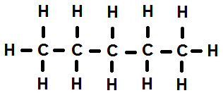
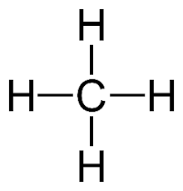
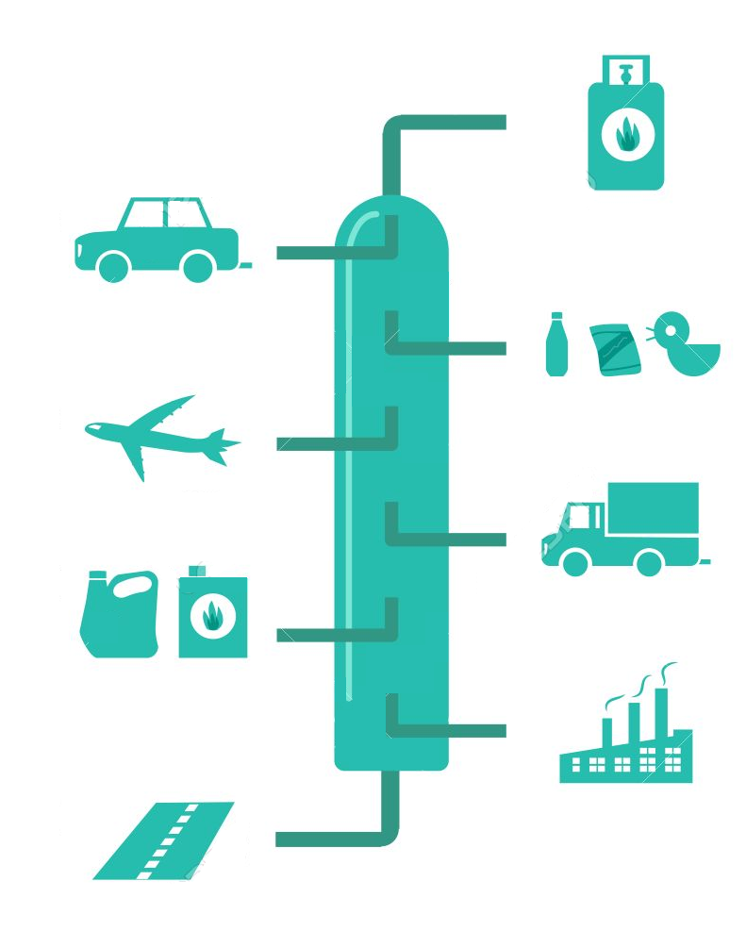
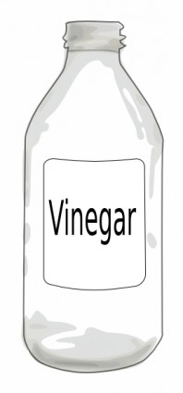
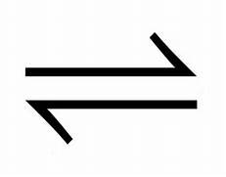
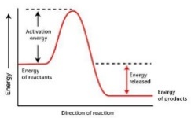
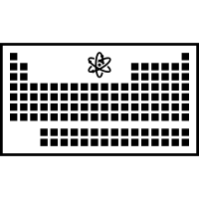
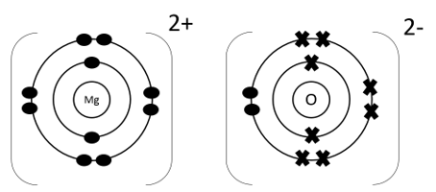
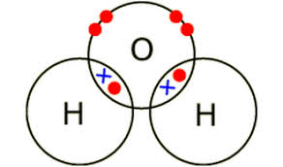
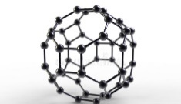
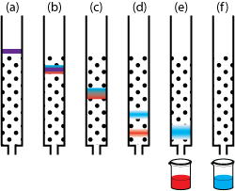
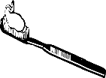
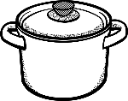
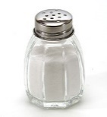
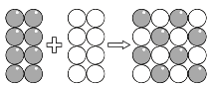
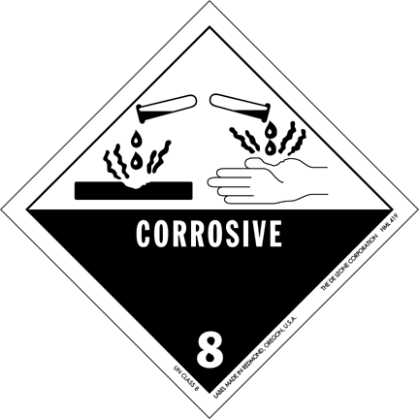
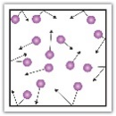
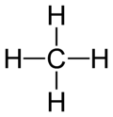
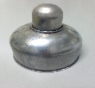
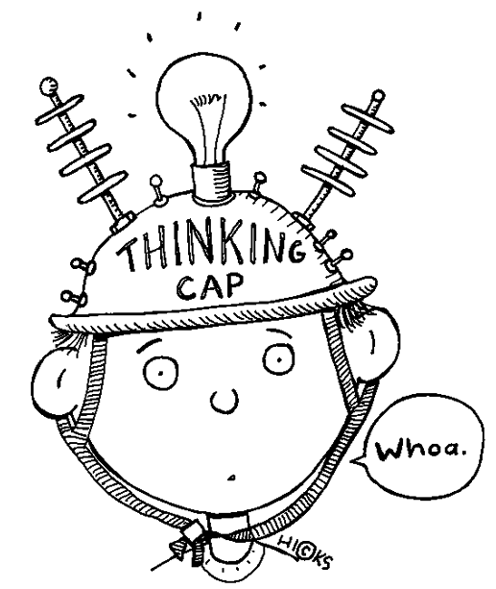
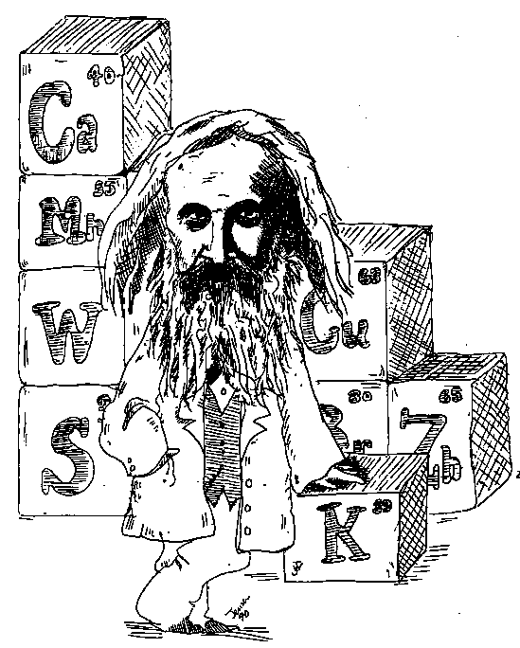
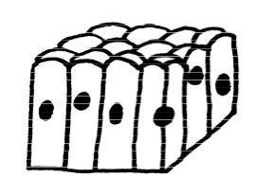
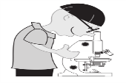
Chemistry Learning Journey
Understanding and Applying Scientific Skills
Glass and Ceramics
Alloys and Rust
Year 7
Year 11
Fertilisers
Polymers
Potable water
Drawing graphs and analysing graphical data
Exam & Post – 16
Destination
Using Resources
Understanding variables
Assessing impact of scientific concepts
Understanding relationships between science and society
Drawing conclusions
Atmospheric pollutants
Writing methods
Modelling scientific concepts
IDEAL
Identify, describe, explain, apply, link
Applying maths to the scientific concepts
Haber Process
Atmosphere
Life cycle assessments and recycling
Testing for ions - precipitation
Greenhouse gases
the
Carbon footprint
Carbon compounds
Alkanes and Alkenes
Chromatography
of
Global Climate Change
YEAR
11
Organic Chemistry
Chemical Analysis
Chemistry
Fractional distillation
Alcohols, carboxylic acids and Esters
Purity and formulations
Testing for Unknown gas
Testing for ions - Flame tests
Testing for ions - spectrometry
Evolution of the Earth’s atmosphere
dynamic equilibrium
Rate
Le Chatelier’s Principle
and
Rate of reaction
Conservation of mass
Expressing Concentration
Atom Economy
Chemical Cells and Batteries
Exothermic and endothermic reactions
Reversible reactions
Extent
of
Chemical
Change
Quantitative Chemistry
Energy Changes
Catalysts
O=C=O
Moles
Fuel Cells
Reaction profiles and bond energies
Change
Electrolysis
Collision Theory
Relative formula mass
Reactions of acids
pH scale
Relative atomic mass
Chemical bonds, ionic, covalent and metallic
Structure and bonding of carbon
Chemical
Reactivity of metals
YEAR
Periodic table
YEAR
Fundamentals of chemistry unit 1
Fundamentals of chemistry unit 2
10
9
10
Climate Change
Recycling
How bonding and structure are related to properties
Model of the atom
Atomic Structure
Nanoparticles
The Carbon Cycle
The Rock Cycle
The Earth
Metal Reactions
Chromatography
Solutions
Group 7
Group 1
Sedimentary, Igneous and Metamorphic Rock
Polymers
Groups and Periods
Metals and Acids
Separation Techniques
The Periodic Table
Ceramics
Displacement Reactions
Evaporation and Distillation
Filtration
Mixtures
Group 0
Metals and Non-Metals
YEAR
8
Compounds
Chemical Reactions
Thermal Decomposition
Exothermic and Endothermic
Acids and Alkalis
Making Salts
Atoms
and
Compounds
Reactions
Acids and Alkalis
Atoms
Chemical Formulae
Word Equations
Burning Fuels
Conservation of Mass
Indicators and pH
Neutralisation
Elements
Elements,
Gas Pressure
Boiling
Melting and Freezing
Collecting and Presenting Data
Scientific Questions
YEAR
Particles and their Behaviour
Working Scientifically
7
Diffusion
Changes of State
States of Matter
The Particle Model
Analysing and Evaluating
Planning Investigations

