Slide 1
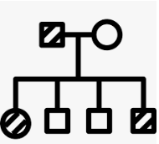
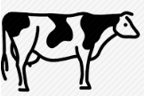
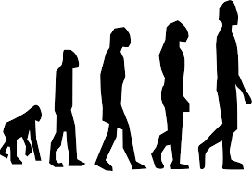
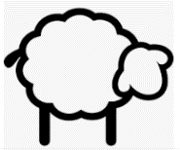
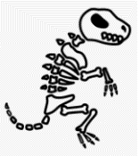
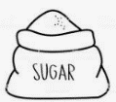
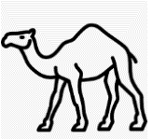
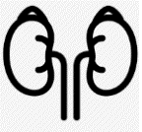
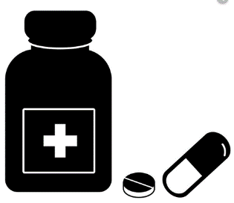
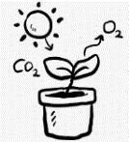
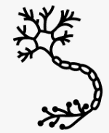
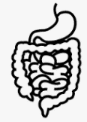
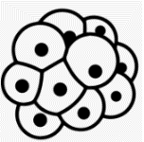
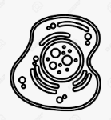
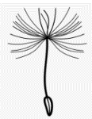
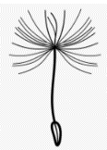
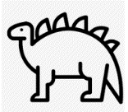
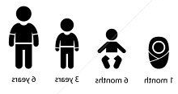
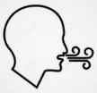
Biology Learning Journey
Year 7
Understanding and Applying Scientific Skills
Year 11
Writing methods
Assessing impact of scientific concepts
Understanding relationships between science and society
IDEAL
Identify, describe, explain, apply, link
Risk Assessment
Understanding variables
Drawing graphs and analysing graphical data
Analysis of secondary data
Modelling scientific concepts
Drawing conclusions
Applying maths to the scientific concepts
Describe patters
Gene expression and mutations
Sex inheritance
Variation
Selective breeding
Ethics of genetic engineering
Theories of evolution- Darwin
Antibiotic resistant bacteria
DNA and the genome
Genetic inheritance
Speciation
Classification
Exam & Post – 16
Destination
Sexual and asexual reproduction
Sexual and
Asexual reproduction
Variation, genetics and evolution
Sustainable fishing
DNA
structure
Protein synthesis
Meiosis
Evolution by natural selection
Genetic engineering
Cloning
Adult cell Cloning
History of genetics
Fossils
Evidence for evolution
Farming techniques
Sustainable food production
Food Production
Factors affecting food security
Predator prey
Adaptations for hot and cold environment
Abiotic and Biotic factors
Transfer of Biomass
11
Water cycle
Decomposition
Sampling techniques
IVF
Diabetes
YEAR
Ecology
Controlling blood glucose
Trophic level
Random Sampling- Quadrats and Transects
Distribution of organisms
Adaptations
Communities
Hormonal control
Carbon cycle
Food chains
Contraception
Menstrual cycle
Endocrine system
Viral diseases
Effect of Light on Photosynthesis
Uses of Glucose
Rate of photosynthesis
Response to exercise
Thermoregulation
Reflex action
Problems with the eye
Sterile technique
Photosynthesis
Respiration
Homeostasis
The nervous system
Structure of the eye
Response
Photosynthesis reaction
Making the most of photosynthesis
Structure and function of the nervous system
The Brain
Discovery and development of drugs
and
Antibiotics and Painkillers
Disease
Anaerobic respiration
Homeostasis
Vaccinations
Fungal and protist diseases
Health & risk factors
Active Transport
Organisation hierachy
Infection
Digestive system
Breathing and gas exchange
Blood
Cancer
Plant organ systems
Mitosis
Diffusion
Human defence systems
YEAR
Microscopy
10
The fundamentals of Biology unit 2
Cell differentiation
Bacterial disease
The fundamentals of Biology unit 1
Prokaryotes and Eukaryotes
Food tests
Respiration
The heart
Blood vessels
CHD
Plant tissues
Transpiration
Chromosomes
Stem cells
Osmosis
Specialised cells
Plant and animal cells
YEAR
Variation
Inheritance
Natural selection
Leaves
9
Food tests
Unhealthy diet
Digestive system
Alcohol
Plant minerals
Aerobic Respiration
Food chains and webs
Natural selection
Adaptation and Inheritance
Health and Lifestyle
Ecosystems
YEAR
Ecosystem Processes
8
Competition and Adaptation
Adapting to change
Continuous and discontinuous variation
Extinction
Chemosynthesis
Disruption to food chains and webs
Nutrients
Drugs
Smoking
Anaerobic Respiration
Seed dispersal
Bacteria and enzymes in digestion
Photosynthesis
Flowers and pollination
Reproduction
The menstrual cycle?
Fertilisation and implantation
Movement: joints
Skeleton
Levels of organisation
Movement of substances
Specialised cells
Observing cells
YEAR
Fertilisation and germination
Body Systems
Cells
7
Development of a fetus
Reproductive systems
Adolescence
Movement: Muscles
Breathing
Gas exchange
Cell division
Unicellular organisms
Plant and animal cells

